Slide 1


Continuous Optimization: Overview
Alberto TONDA, Senior Researcher (DR)
UMR 518 MIA-PS (Applied Mathematics and Computer Science) INRAE, AgroParisTech, Université Paris-Saclay Institut des Systèmes Complexes, Paris-Ile-de-France

Slide 2
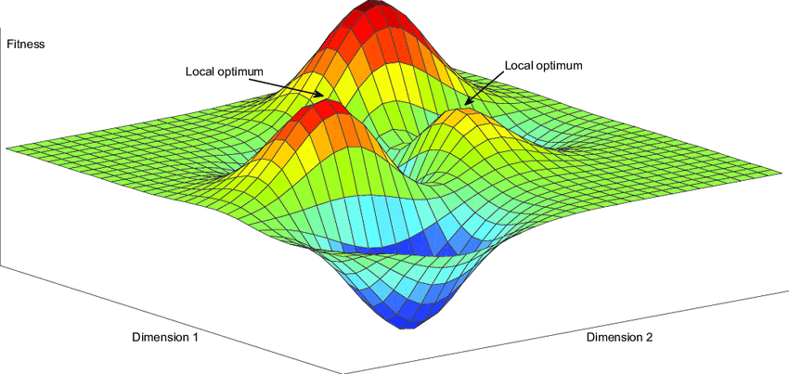
Outline
Gradient-based
Gradient descent
Successors of gradient descent
Stochastic/Approximate
Basin-hopping
Evolutionary algorithms

Slide 3
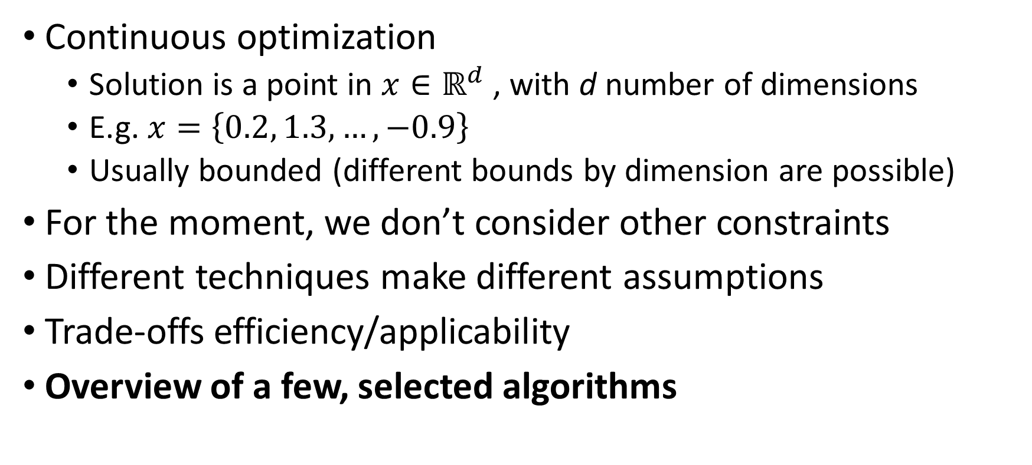
Introduction
Continuous optimization
Solution is a point in $x∈ℝ^{d}$ , with d number of dimensions
E.g. $x=\left\{0.2, 1.3,…,−0.9\right\}$
Usually bounded (different bounds by dimension are possible)
For the moment, we don’t consider other constraints
Different techniques make different assumptions
Trade-offs efficiency/applicability
Overview of a few, selected algorithms

Slide 4
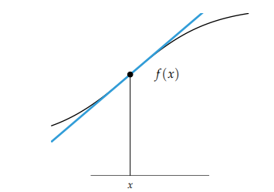
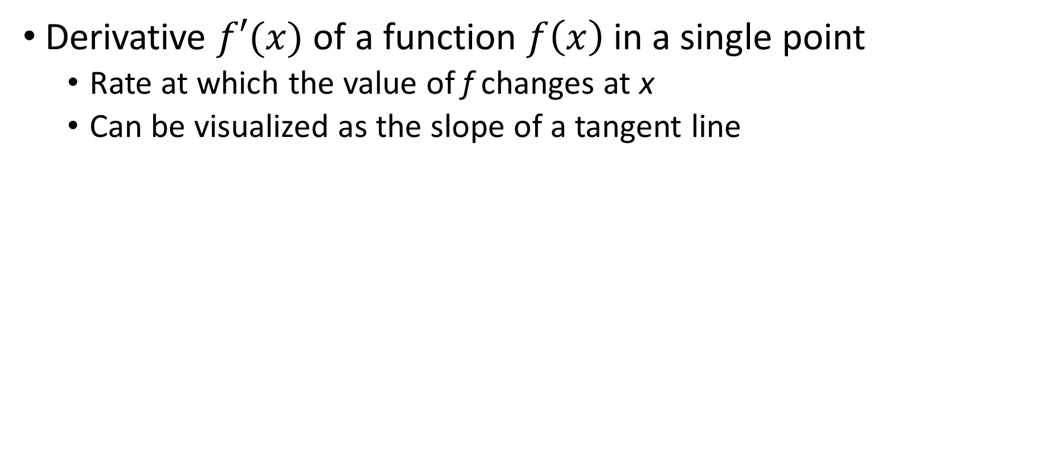
Gradient-based techniques
Derivative $f′(x)$ of a function $f\left(x\right)$ in a single point
Rate at which the value of f changes at x
Can be visualized as the slope of a tangent line

Slide 5
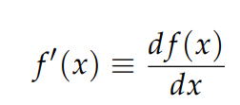
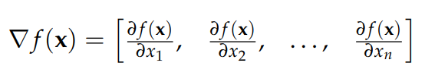
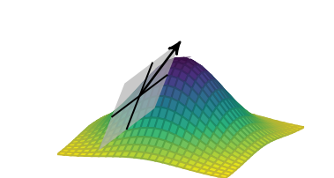
Gradient-based techniques
Different interchangeable notations
Derivative in multiple dimensions is the gradient (Jacobian)

Slide 6
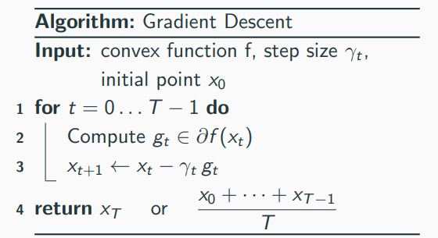
Gradient-based techniques
Simple intuition: always follow steepest descent/ascent
Assumptions
Gradient can be computed
Or approximated
Function is convex (guarantees global optimum)
Also runs on non-convex functions

Slide 7
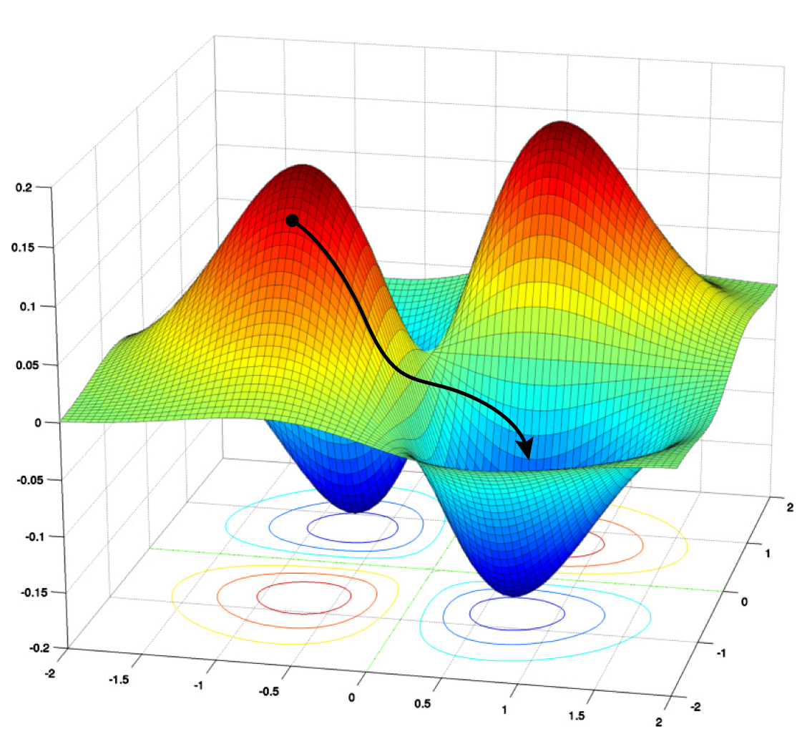
Gradient-based techniques
Simple intuition: always follow steepest descent/ascent
Assumptions
Gradient can be computed
Or approximated
Function is convex (guarantees global optimum)
Also runs on non-convex functions

Slide 8

Issues with gradient-based techniques
Brainstorming!

Slide 9

Issues with gradient-based techniques
Hard/impossible to get out of local optima
Starting point of exploration matters
Step size? Too small / too large leads to convergence issues

Slide 10
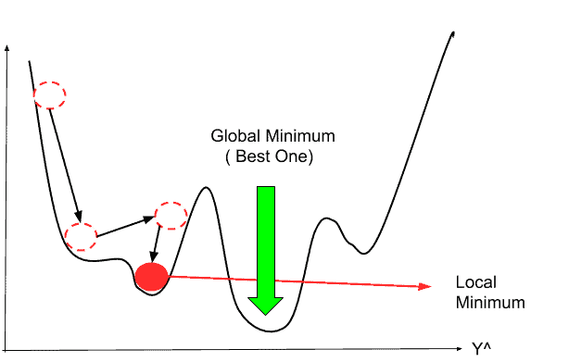
Issues with gradient-based techniques
Starting point of exploration matters

Slide 11
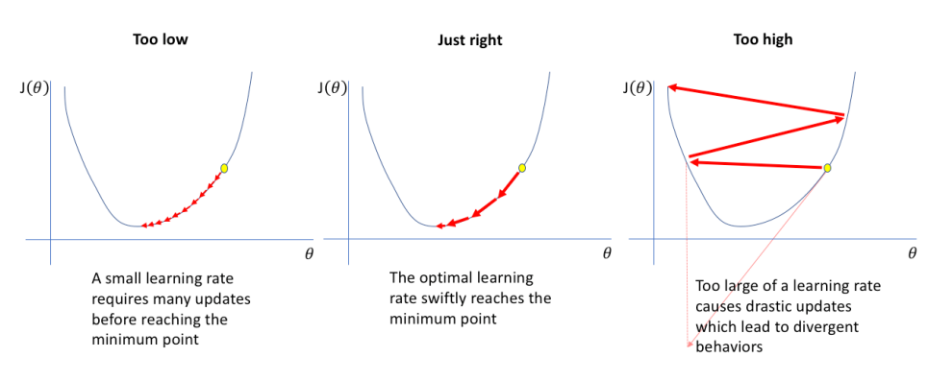
Issues with gradient-based techniques
Step size? Too small / too large lead to convergence issues

Slide 12
Gradient-based techniques for neural networks
Why are gradient-based techniques so successful?
Actually, stochastic gradient descent (SGD) & descendants
Techniques made popular by (deep) neural networks
State-of-the-art for NNs, not very used elsewhere
Can escape local optima!

Slide 13
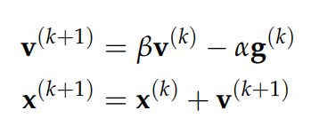
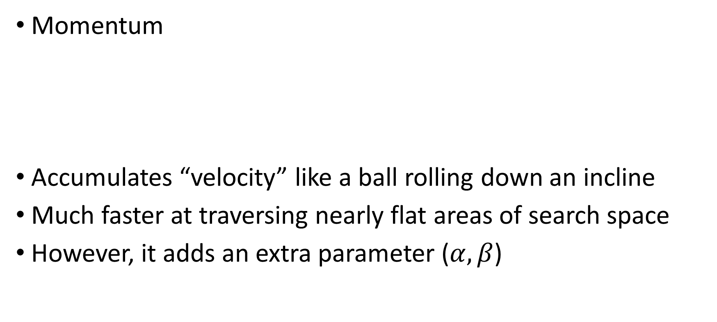
Modern gradient-based techniques
Momentum
Accumulates “velocity” like a ball rolling down an incline
Much faster at traversing nearly flat areas of search space
However, it adds an extra parameter ($α,β$)

Slide 14
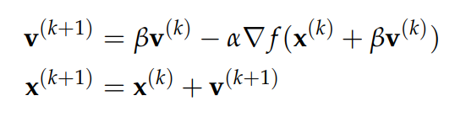
Modern gradient-based techniques
And now it cumulates too much momentum!
Nesterov momentum
I evaluate the gradient at the point I plan to end in
And rescale my velocity accordingly

Slide 15
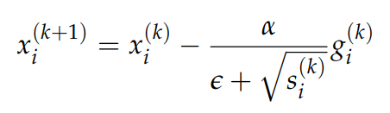
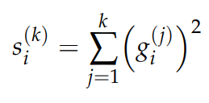
Modern gradient-based techniques
Further issues motivated further advances (Adagrad)
The step size could be different in each dimension
Maintain a “memory” of the gradient values in each direction
However, this led to the step size always decreasing

Slide 16
Modern gradient-based techniques
Solutions to issues of previous algorithms create new issues
Latest (Adam and RMSProp) have 3-4 (hyper)parameters
Default values work reasonably well (but not always)

Slide 17

Modern gradient-based techniques

Slide 18

Stochastic/Approximate techniques
Limitations of gradient-based techniques were evident
Practical problems had objective functions with local optima
You can randomly sample the search space…
…but exploiting feedback/function characteristics is better!

Slide 19
PSEUDO-random number generation
Important caveat!
“Random” numbers in a computer are NOT random
Specialized algorithms can produce long sequences of numbers
…but in the end they repeat (!!), they have a period
Details are complex and out of scope: see Mersenne Twister
Concrete consequences
PRNG algorithms need to be initialized with random seed
All sequences that start from same random seed are identical
Storing and setting random seed ensures repeatability of experiments

Slide 20
PSEUDO-random number generation
STORE THE RANDOM SEED

Slide 21
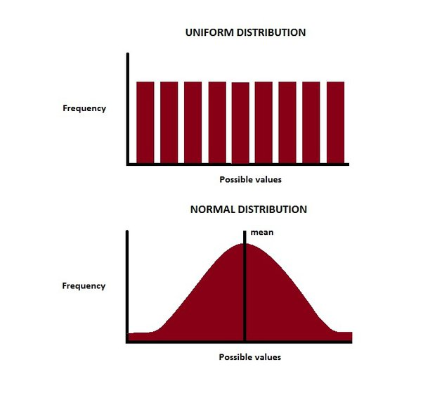
PSEUDO-random number generation
Most of the continuous values we extract
Either sampling a Gaussian distribution
Or uniform distribution

Slide 22

Brainstorming!
How to use stochasticity to go beyond limitations of gradient-based techniques?

Slide 23
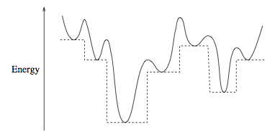
Basin-hopping
Developed starting from a practical application
Protein folding, can compute derivative of objective function
However, it does contain several local optima

Slide 24
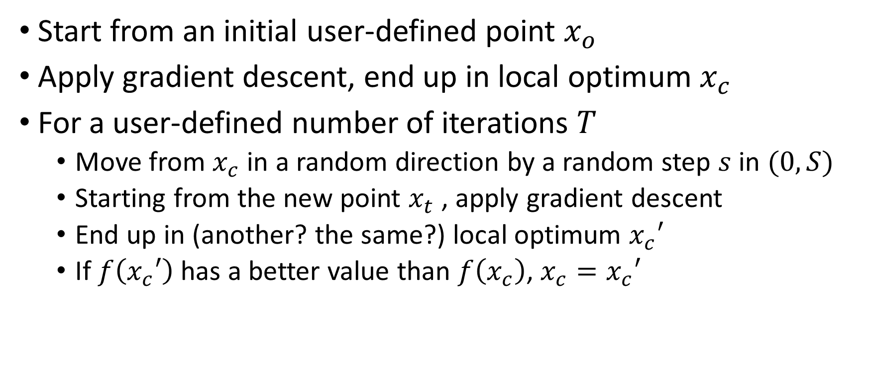
Basin-hopping
Start from an initial user-defined point $x_{o}$
Apply gradient descent, end up in local optimum $x_{c}$
For a user-defined number of iterations $T$
Move from $x_{c}$ in a random direction by a random step $s$ in $(0, S)$
Starting from the new point $x_{t}$ , apply gradient descent
End up in (another? the same?) local optimum $x_{c}′$
If $f\left(x_{c}′\right)$ has a better value than $f\left(x_{c}\right)$, $x_{c}=x_{c}′$

Slide 25
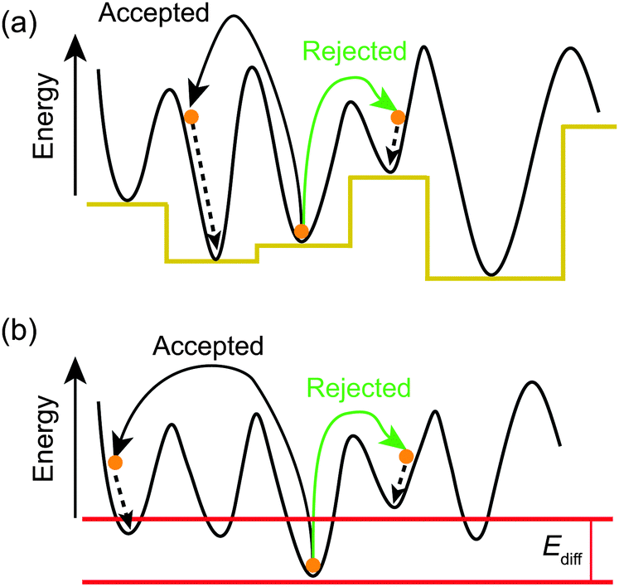
Basin-hopping

Slide 26
Evolutionary algorithms
But what if our objective function is not derivable?
Can we use only the feedback from the function…
…and do better than random?
Assumption: “good candidate solutions are usually close to other good solutions”

Slide 27
Evolutionary algorithms
Evolutionary algorithms
Genetic algorithms
Evolutionary programming
Evolution strategies
Genetic programming

Slide 28
Evolutionary algorithms
Stochastic optimization techniques
Sample search space, proceed with “natural selection” of candidate solutions
“Memory” of search space with current set of candidate solutions
Best solutions “reproduce” more often
New solutions are a slightly altered version of parents
Evaluate solution performance
Individuals
Population
Offspring
Fitness
Notes:
They can be used for other purposes, but in this presentation I will focus on optimization. Who here has used evolutionary algorithms, also known as “Genetic Algorithms”?
They are inspired by the neo-Darwinian understanding of natural selection. But keep in mind that this is just a metaphor, they are as close to natural selection as artificial neural networks are close to the brain, which means, very little.
There is some domain-specific terminology that I will try not to use too much. But basically, a candidate solution is sometimes called “individual”; the set of candidate solutions at the current iteration is called “population”; and the new solutions produced at each iteration are called “offspring”

Slide 29
Evolutionary algorithms
Return best solution(s)
Yes
Stop condition reached?
Generate and evaluate
initial population
Select parents and create offspring
Evaluate new solutions
Remove worst solutions
No

Slide 30
Evolutionary algorithms
Random sampling
Return best solution(s)
Yes
Stop condition reached?
Generate and evaluate
initial population
Select parents and create offspring
Evaluate new solutions
Remove worst solutions
No

Slide 31
Evolutionary algorithms
Select random (existing) points with probability proportional to their function value
Return best solution(s)
Yes
Stop condition reached?
Generate and evaluate
initial population
Select parents and create offspring
Evaluate new solutions
Remove worst solutions
No

Slide 32
Evolutionary algorithms
Modify the points a little, creating new points
Return best solution(s)
Yes
Stop condition reached?
Generate and evaluate
initial population
Select parents and create offspring
Evaluate new solutions
Remove worst solutions
No

Slide 33
Evolutionary algorithms
Creating new points (offspring)
Mutation (e.g. small perturbation of coordinates)
[0.52, 0.24] -> [0.55, 0.24]
[0.52, 0.24] -> [0.49, 0.28]
Crossover
[0.52, 0.24] and [0.19, 0.82] -> [0.52, 0.82] and [0.19, 0.24]
[0.52, 0.24] and [0.19, 0.82] -> -> [(0.52 + 0.19)/2, (0.82 + 0.24)/2] -> [0.355, 0.530]

Slide 34
Evolutionary algorithms
Update the population (archive), discarding solutions based on the objective function value
Return best solution(s)
Yes
Stop condition reached?
Generate and evaluate
initial population
Select parents and create offspring
Evaluate new solutions
Remove worst solutions
No

Slide 35
Evolutionary algorithms
Stop condition: number of iterations/generations, or quality of the solution (close enough)
Return best solution(s)
Yes
Stop condition reached?
Generate and evaluate
initial population
Select parents and create offspring
Evaluate new solutions
Remove worst solutions
No

Slide 36

Issues with stochastic techniques
Large number of evaluations required
Exploration vs exploitation / step size
In general, LOTS OF (hyper)PARAMETERS

Slide 37
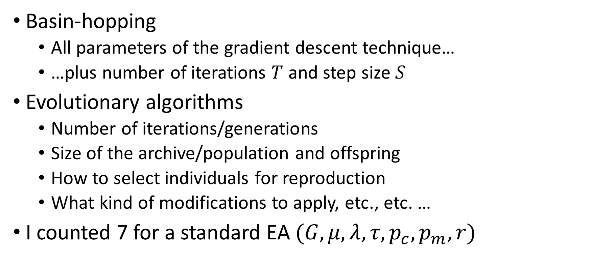
Issues with stochastic techniques
Basin-hopping
All parameters of the gradient descent technique…
…plus number of iterations $T$ and step size $S$
Evolutionary algorithms
Number of iterations/generations
Size of the archive/population and offspring
How to select individuals for reproduction
What kind of modifications to apply, etc., etc. …
I counted 7 for a standard EA $(G,μ,λ,τ,p_{c},p_{m}, r)$

Slide 38
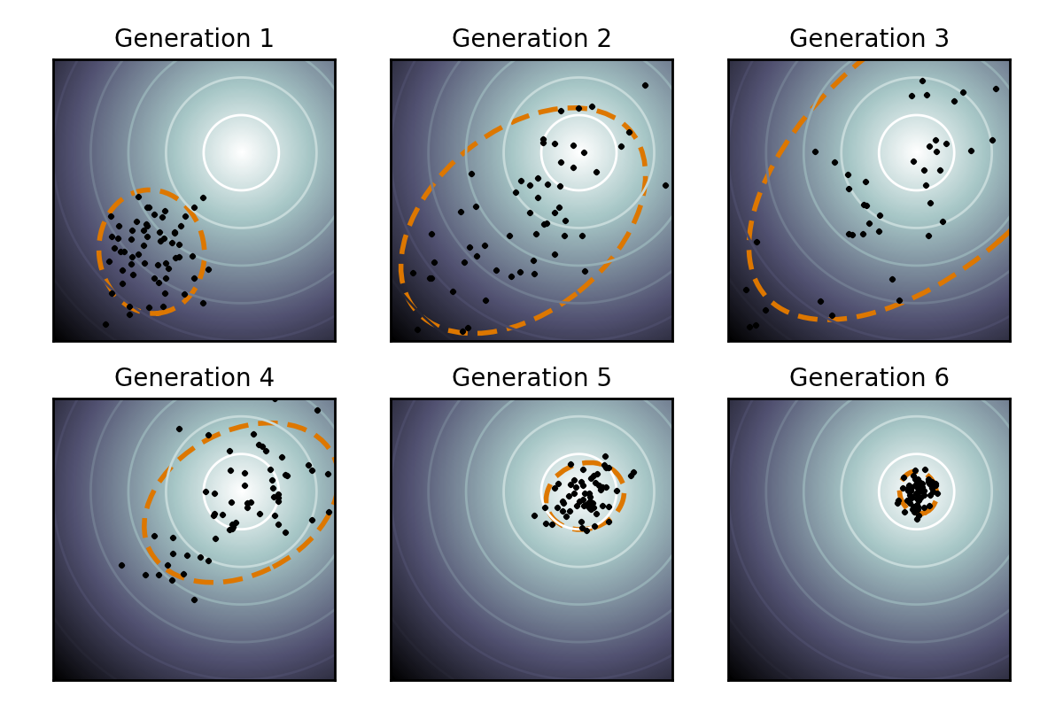
Modern evolutionary algorithms
Covariance Matrix Adaptation Evolution Strategy (CMA-ES)

Slide 39
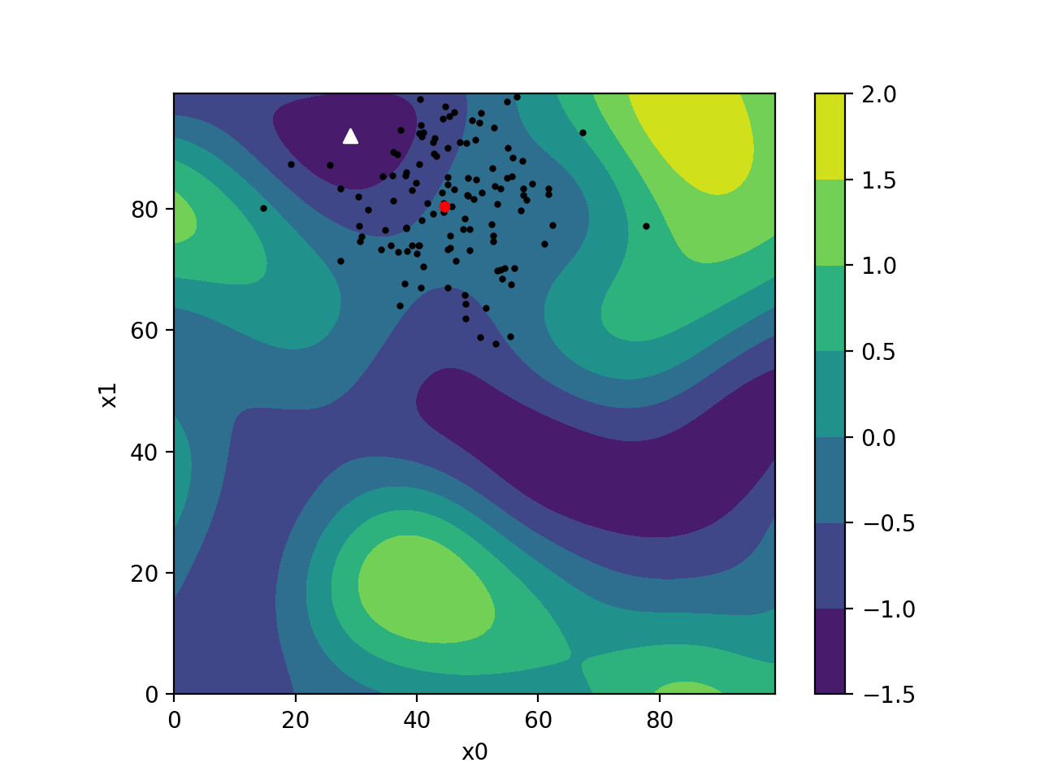
Modern evolutionary algorithms

Slide 40
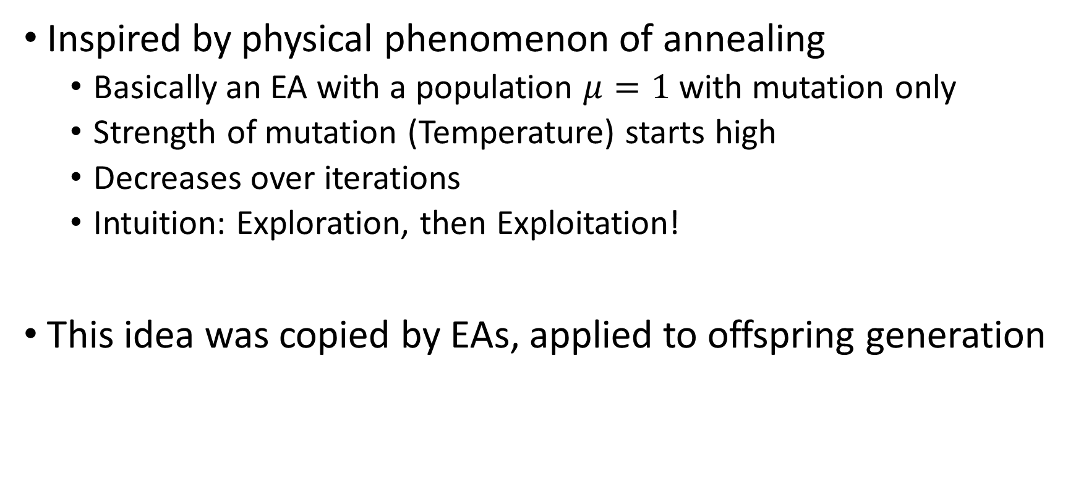
Simulated annealing
Inspired by physical phenomenon of annealing
Basically an EA with a population $μ=1$ with mutation only
Strength of mutation (Temperature) starts high
Decreases over iterations
Intuition: Exploration, then Exploitation!
This idea was copied by EAs, applied to offspring generation

Slide 41
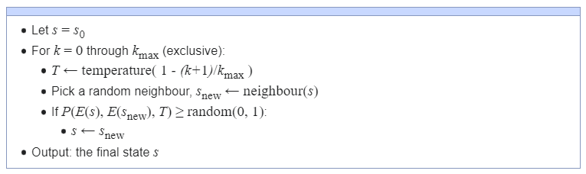

Simulated annealing

Slide 42
Questions?
Bibliography - Kochenderfer & Wheeler, Algorithms for Optimization, MIT Press, 2019 - De Jong, Evolutionary Computation: A Unified Approach, 2016
Images: unless otherwise stated, I stole them from the Internet. I hope they are not copyrighted, or that their use falls under the Fair Use clause, and if not, I am sorry. Please don’t sue me.

